Slide 1
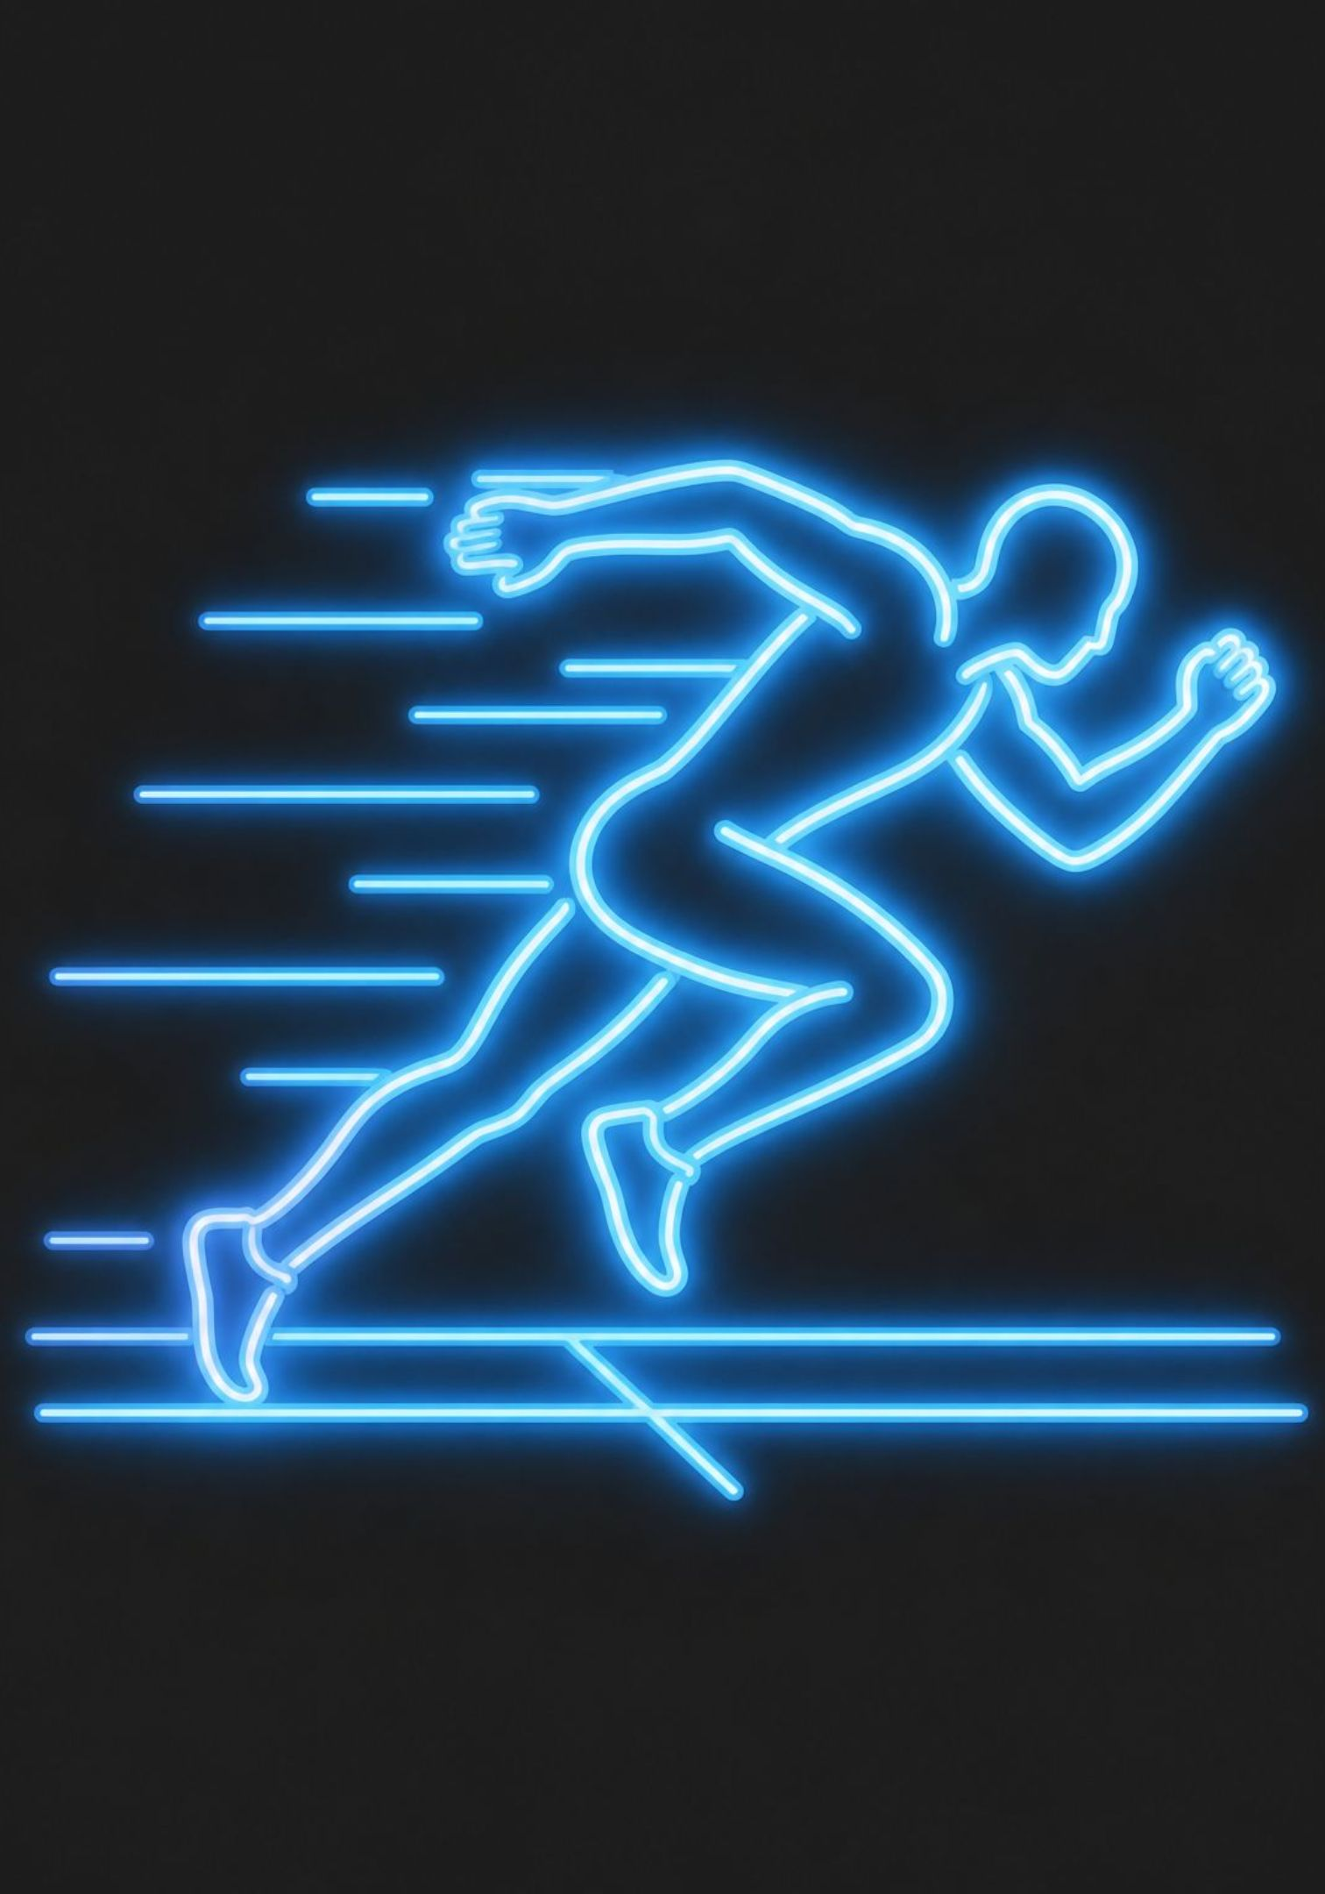

AI in Sports
Transforming Performance, Strategy, and Fan Experience
Presented by: Yug Dandawala

Slide 2

Introduction to AI in Sports
What is AI?
Artificial Intelligence enables machines to analyze data and make intelligent decisions.
Who Uses It?
AI is used by athletes, coaches, referees, and sports organizations worldwide.
What Does It Do?
It processes large amounts of player and match data quickly to improve performance, decision-making, and safety.
Why It Matters
AI is becoming an essential part of modern sports at every level.

Slide 3
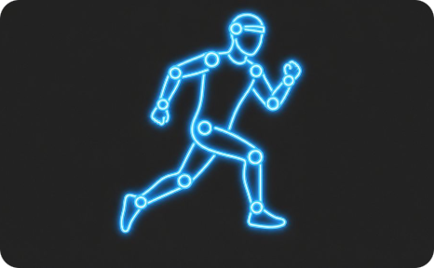
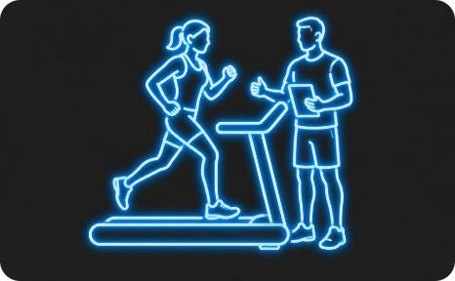


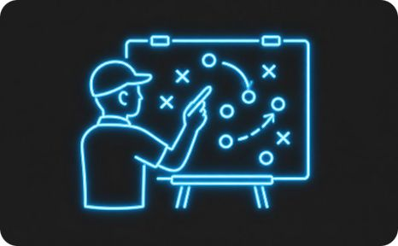
Applications of AI in Sports
Performance Analysis
Training & Coaching
Injury Prevention
Tracks speed, movement, and player statistics in real time.
Creates personalized training plans tailored to each athlete.
Detects fatigue and predicts injury risks before they occur.
Officiating
Game Strategy
Supports decisions using technologies like VAR and Hawk-Eye.
Analyzes opponents and suggests optimal tactics.

Slide 4

Benefits of AI in Sports
Enhanced Performance
Injury Reduction
Faster Decisions
Improves athlete performance using data-driven insights.
Reduces injuries through continuous health monitoring.
Enables faster and more accurate decision-making on and off the field.
Smarter Strategy
Fan Experience
Enhances the fan experience with live analytics and personalized content.
Helps coaches develop better match strategies.

Slide 5

Challenges and Limitations
💰 High Costs
🔒 Privacy Concerns
📊 Data Quality
Implementation and maintenance of AI systems require significant investment.
Collecting and storing athlete performance data raises serious privacy issues.
AI predictions are only as good as the quality of available data.
⚖️ Over-Reliance
🏟️ Accessibility Gap
Excessive dependence on technology may reduce human judgment and intuition.
Not all sports organizations can afford advanced AI systems.
Balancing innovation with ethics and accessibility is key to responsible AI adoption in sports.

Slide 6
Future of AI in Sports
Wearable Devices
1
AI-powered wearables for real-time athlete monitoring.
2
Smart Stadiums
Personalized fan experiences powered by intelligent systems.
Injury Prediction
3
More accurate injury forecasting and recovery planning.
4
Talent Scouting
AI-assisted identification and recruitment of future stars.
Ethical AI
5
Responsible and transparent use of AI will become increasingly important.

Slide 7

Thank You
Thank you for your attention.

